Slide 1
Discrete Structures
CS-1005
GCR: e2d2awt
Lecture-9

Slide 2

Equivalent Forms of Universal and Existential Statements
Observe that the two statements “∀ real numbers x, if x is an integer then x is rational” and “∀ integers x, x is rational” mean the same thing.
Both have informal translations “All integers are rational.” In fact, a statement of the form
can always be rewritten in the form
by narrowing U to be the domain D consisting of all values of the variable x that make P(x) true.

Slide 3

Equivalent Forms of Universal and Existential Statements
Conversely, a statement of the form
can be rewritten as

Slide 4
Equivalent Forms of Universal and Existential Statements
Rewrite the following statement in the two forms “∀ x, if then ” and “∀ x, ”: All squares are rectangles.
Solution:
∀x, if x is a square then x is a rectangle.
∀ squares x, x is a rectangle.

Slide 5
Equivalent Forms of Universal and Existential Statements
Similarly, a statement of the form
“∃ x such that p(x) and Q(x)”
can be rewritten as
“∃ x εD such that Q(x),”
where D is the set of all x for which P(x) is true.

Slide 6
Equivalent Forms of Universal and Existential Statements
A prime number is an integer greater than 1 whose only positive integer factors are itself and 1. Consider the statement “There is an integer that is both prime and even.”
Let Prime(n) be “n is prime” and Even(n) be “n is even.” Use the notation Prime(n) and Even(n) to rewrite this statement in the following two forms:
∃ n such that ∧ .
∃ n such that .

Slide 7
Equivalent Forms of Universal and Existential Statements
∃ n such that Prime(n) ∧ Even(n).
Two answers: ∃ a prime number n such that Even(n).
∃ an even number n such that Prime(n).

Slide 8
Implicit Quantification
Mathematical writing contains many examples of implicitly quantified statements. Some occur, through the presence of the word a or an. Others occur in cases where the general context of a sentence supplies part of its meaning.
For example, in an algebra course in which the letter x is always used to indicate a real number, the predicate
If x > 2 then x² > 4
is interpreted to mean the same as the statement
∀ real numbers x, if x > 2 then x² > 4.

Slide 9
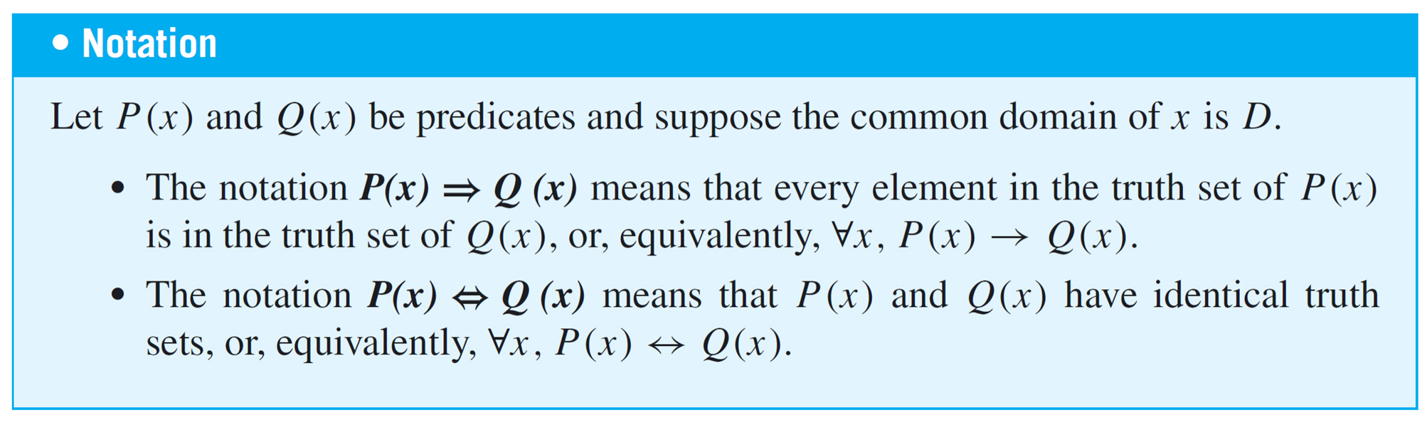
Implicit Quantification
Mathematicians often use a double arrow to indicate implicit quantification symbolically.
For instance, they might express the above statement as
x > 2 ⇒ x² > 4.

Slide 10
Tarski’s World
Tarski’s World is a computer program developed by information scientists Jon Barwise and John Etchemendy to help teach the principles of logic.
It is described in their book The Language of First-Order Logic, which is accompanied by a CD-Rom containing the program Tarski’s World, named after the great logician Alfred Tarski.

Slide 11
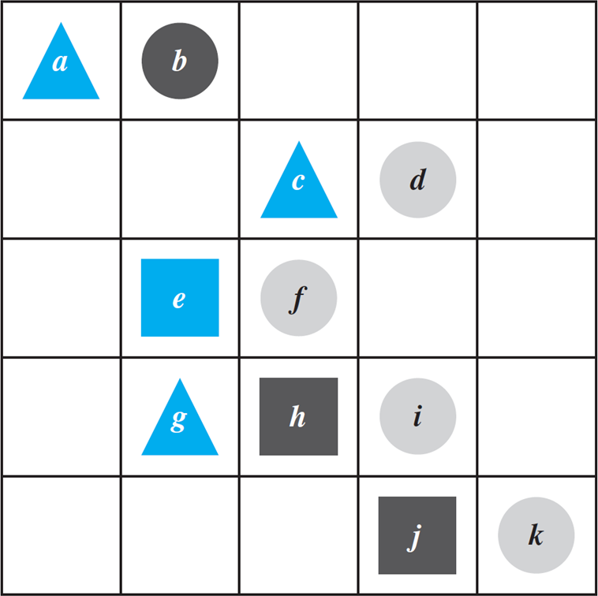
Tarski’s World
The configuration can be described using logical operators and—for the two-dimensional version—notation such as Triangle(x), meaning “x is a triangle,” Blue(y), meaning “y is blue,” and RightOf(x, y), meaning “x is to the right of y (but possibly in a different row).” Individual objects can be given names such as a, b, or c.

Slide 12
Tarski’s World
Determine the truth or falsity of each of the following statements. The domain for all variables is the set of objects in the Tarski world shown above.
∀ t, Triangle(t) → Blue(t).
∀ x, Blue(x) → Triangle(x).
∃ y such that Square(y) ∧ RightOf(d, y).
∃ z such that Square(z) ∧ Gray(z).

Slide 13
Tarski’s World
This statement is true: All the triangles are blue.
This statement is false. As a counterexample, note that e
is blue and it is not a triangle.
This statement is true because e and h are both square and d is to their right.
This statement is false: All the squares are either blue or black.

Slide 14
Negations of Quantified Statements
“All mathematicians wear glasses”
No mathematicians wear glasses?
“There is at least one mathematician who does not wear glasses.”

Slide 15
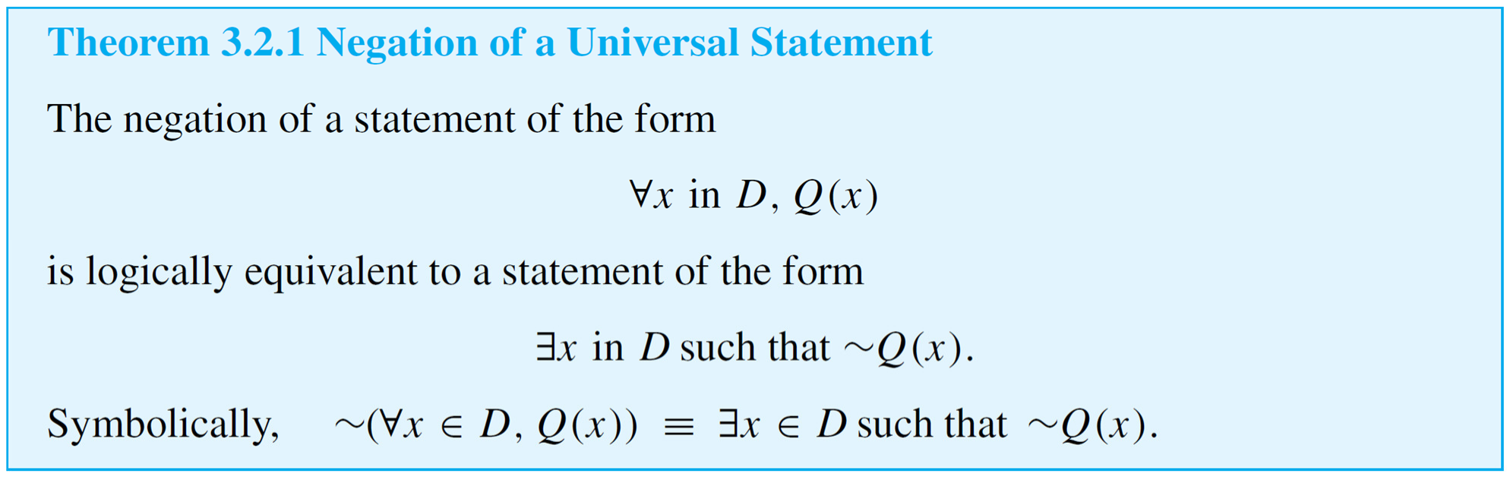
Negations of Quantified Statements
The negation of a universal statement (“all are”) is logically equivalent to an existential statement (“some are not” or “there is at least one that is not”).

Slide 16
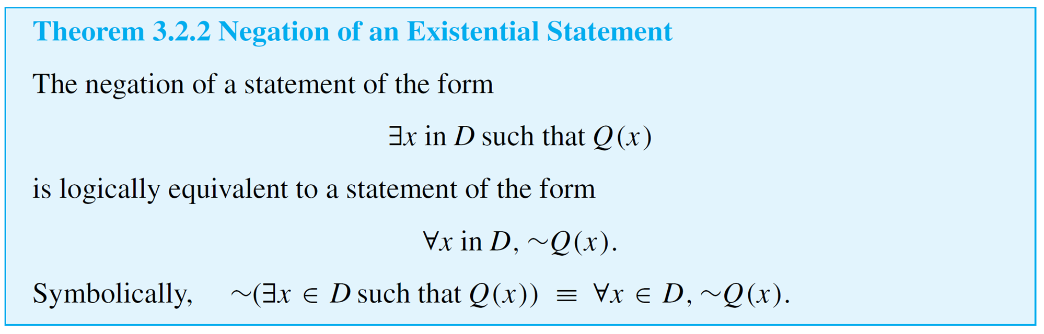
Negations of Quantified Statements
“Some snowflakes are the same.”
“No snowflakes are the same,”
“All snowflakes are different.”
Thus
The negation of an existential statement (“some are”) is logically equivalent to a universal statement (“none are” or “all are not”).

Slide 17
Negations of Quantified Statements
Write formal negations for the following statements:
∀ primes p, p is odd.
∃ a triangle T such that the sum of the angles of T
equals 200°.
Solution:
a. By applying the rule for the negation of a ∀ statement, you can see that the answer is
∃ a prime p such that p is not odd.

Slide 18
Negations of Quantified Statements
b. By applying the rule for the negation of a ∃ statement, you can see that the answer is
∀ triangles T, the sum of the angles of T does not equal 200°.

Slide 19
Quantified Statements
The negation of a for all statement is a there exists statement, and the negation of a there exists statement is a for all statement.
These facts are analogous to De Morgan’s laws, which state that the negation of an and statement is an or statement and that the negation of an or statement is an and statement.
This similarity is not accidental. In a sense, universal statements are generalizations of and statements, and existential statements are generalizations of or statements.

Slide 20

Quantified Statements
If Q(x) is a predicate and the domain D of x is the set {x₁, x₂, . . . , x_{n}}, then the statements
and
are logically equivalent.

Slide 21

Quantified Statements
Similarly, if Q(x) is a predicate and D = {x₁, x₂, . . . , x_{n}}, then the statements
and
are logically equivalent.

Slide 22

Vacuous Truth of Universal Statements
Suppose a bowl sits on a table and next to the bowl is a pile of five blue and five gray balls, any of which may be placed in the bowl.
If three blue balls and one gray ball are placed in the bowl, as shown in Figure the statement “All the balls in the bowl are blue” would be false (since one of the balls in the bowl is gray).

Slide 23

Vacuous Truth of Universal Statements
Now suppose that no balls at all are placed in the bowl, as shown in Figure
Consider the statement
All the balls in the bowl are blue.

Slide 24
Vacuous Truth of Universal Statements
Is this statement true or false? The statement is false if, and only if, its negation is true.
And its negation is
There exists a ball in the bowl that is not blue.
But the only way this negation can be true is for there actually to be a nonblue ball in the bowl.
And there is not! Hence the negation is false, and so the statement is true “by default.”

Slide 25
Vacuous Truth of Universal Statements
In general, a statement of the form
is called vacuously true or true by default if, and only if,
P(x) is false for every x in D.

Slide 26
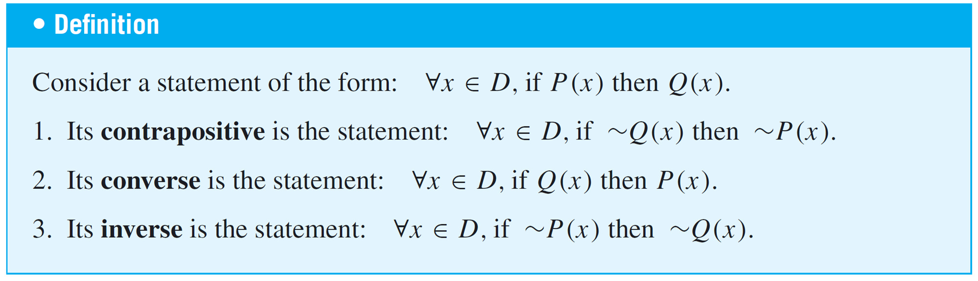
Variants of Universal Conditional Statements
We have known that a conditional statement has a contrapositive, a converse, and an inverse.
The definitions of these terms can be extended to universal conditional statements.

Slide 27
Variants of Universal Conditional Statements
Write a formal and an informal contrapositive, converse, and inverse for the following statement:
If a real number is greater than 2, then its square is greater than 4.
Solution:
The formal version of this statement is
∀x ∈ R, if x > 2 then x² > 4.

Slide 28
Variants of Universal Conditional Statements
Contrapositive: ∀x ∈ R, if x² ≤ 4 then x ≤ 2.
Or: If the square of a real number is less than or equal to 4, then the number is less than or equal to 2.
Converse: ∀x ∈ R, if x² > 4 then x > 2.
Or: If the square of a real number is greater than 4, then the number is greater than 2.
Inverse: ∀x ∈ R, if x ≤ 2 then x² ≤ 4. Or: If a real number is less than or equal to 2, then the square of the number is less than or equal to 4.

Slide 29
Statements with multiple Quantifiers
When a statement contains more than one quantifier, we imagine the actions suggested by the quantifiers as being performed in the order in which the quantifiers occur.
For instance, consider a statement of the form
∀x in set D, ∃y in set E such that x and y satisfy property P(x, y).

Slide 30
Statements with multiple Quantifiers
To show that such a statement is true, you must be able to meet the following challenge:
•Imagine that someone is allowed to choose any element whatsoever from the set D, and imagine that the person gives you that element. Call it x.
•The challenge for you is to find an element y in E so that the person’s x and your y, taken together, satisfy property P(x, y).

Slide 31
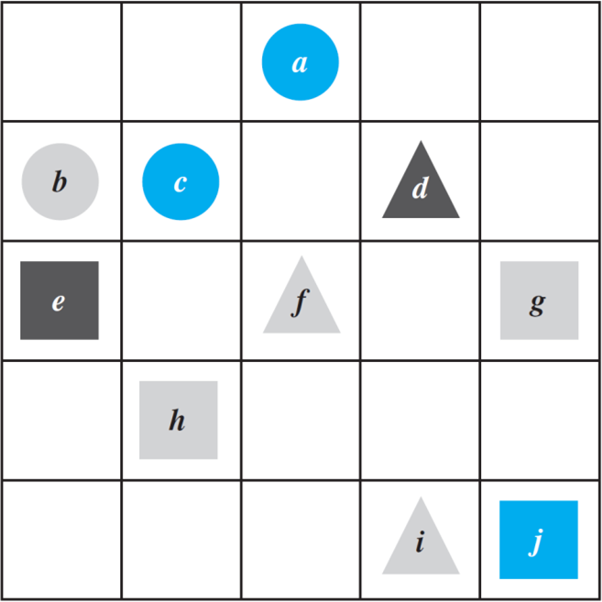
Statements with multiple Quantifiers
Consider the Tarski world shown in Figure
Show that the following statement is true in this world: For all triangles x, there is a square y such that x and y have the same color.

Slide 32
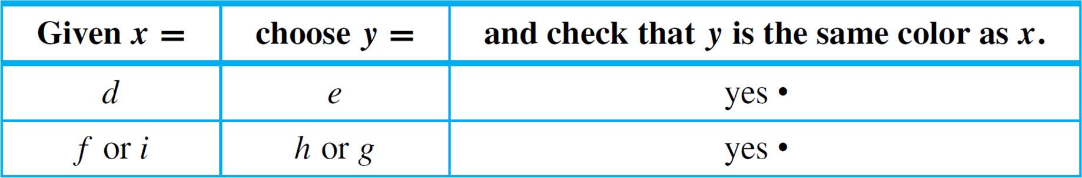
Statements with multiple Quantifiers
The statement says that no matter which triangle someone gives you, you will be able to find a square of the same color. There are only three triangles, d, f, and i.
The following table shows that for each of these triangles a square of the same color can be found.

Slide 33
Statements with multiple Quantifiers
Now consider a statement containing both ∀ and ∃, where the ∃ comes before the ∀:
∃ an x in D such that ∀y in E, x and y satisfy property
P(x, y).
To show that a statement of this form is true:
You must find one single element (call it x) in D with the following property:
•After you have found your x, someone is allowed to choose any element whatsoever from E. The person challenges you by giving you that element. Call it y.
•Your job is to show that your x together with the person’s y
satisfy property P(x, y).

Slide 34
Statements with multiple Quantifiers
Here is a summary of the convention for interpreting statements with two different quantifiers:
Interpreting Statements with Two Different Quantifiers
If you want to establish the truth of a statement of the form
∀x in D, ∃y in E such that P(x, y)
your challenge is to allow someone else to pick whatever element x in D they wish and then you must find an element y in E that “works” for that particular x.

Slide 35
Statements with multiple Quantifiers
If you want to establish the truth of a statement of the form
∃x in D such that ∀y in E, P(x, y)
your job is to find one particular x in D that will “work” no matter what y in E anyone might choose to challenge you with.

Slide 36
Statements with multiple Quantifiers
A college cafeteria line has four stations: salads, main courses, desserts, and beverages.
The salad station offers a choice of green salad or fruit salad; the main course station offers spaghetti or fish; the dessert station offers pie or cake; and the beverage station offers milk, soda, or coffee. Three students, Uta, Tim, and Yuen, go through the line and make the following choices:
Uta: green salad, spaghetti, pie, milk
Tim: fruit salad, fish, pie, cake, milk, coffee Yuen: spaghetti, fish, pie, soda

Slide 37
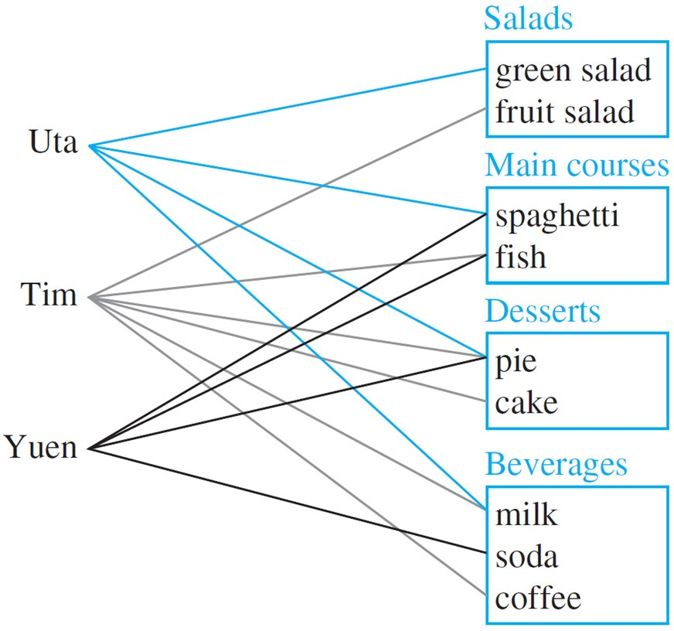
Statements with multiple Quantifiers
Write each of following statements informally and find its truth value.
∃ an item I such that ∀ students S, S chose I.
∃ a student S such that ∀ items I, S chose I.
∃ a student S such that ∀ stations Z, ∃ an item I in Z
such that S chose I.
∀ students S and ∀ stations Z, ∃ an item I in Z such that
S chose I.

Slide 38
Statements with multiple Quantifiers
There is an item that was chosen by every student. This is true; every student chose pie.
There is a student who chose every available item. This is false; no student chose all nine items.
There is a student who chose at least one item from every station. This is true; both Uta and Tim chose at least one item from every station.
Every student chose at least one item from every station. This is false; Yuen did not choose a salad.

Slide 39
Negations of Multiple Quantified Statements
You can use the same rules to negate multiply-quantified statements that you used to negate simpler quantified statements.
We have known that
∼(∀x in D, P(x)) ≡ ∃x in D such that ∼P(x).
and
∼(∃x in D such that P(x)) ≡ ∀x in D,∼P(x).

Slide 40
Negations of Multiple Quantified Statements
We apply these laws to find
∼(∀x in D, ∃y in E such that P(x, y))
by moving in stages from left to right along the sentence.
First version of negation: ∃x in D such that ∼(∃y in E such
that P(x, y)).
Final version of negation: ∃x in D such that ∀y in E,
∼P(x, y).

Slide 41
Negations of Multiple Quantified Statements
Similarly, to find
∼(∃x in D such that ∀y in E, P(x, y)),
we have
First version of negation: ∀x in D,∼(∀y in E, P(x, y)). Final version of negation: ∀x in D, ∃y in E such that
∼P(x, y).

Slide 42
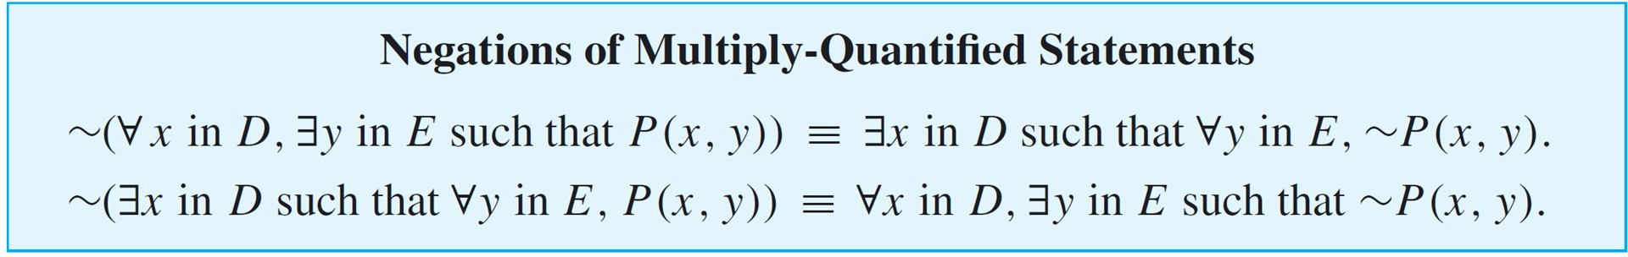
Negations of Multiple Quantified Statements
These facts can be summarized as follows:

Slide 43

Negations of Multiple Quantified Statements
Refer to the Tarski world of Figure.
Write a negation for each of the following statements, and determine which is true, the given statement or its negation.
a. For all squares x, there is a circle y such that x and y have the same color.
b. There is a triangle x such that for all squares y, x is to the right of y.

Slide 44
Negations of Multiple Quantified Statements
First version of negation: ∃ a square x such that
∼(∃ a circle y such that x and y
have the same color).
Final version of negation: ∃ a square x such that
∀ circles y, x and y do not have the same color.
The negation is true. Square e is black and no circle is black, so there is a square that does not have the same color as any circle.

Slide 45
Negations of Multiple Quantified Statements
First version of negation: ∀ triangles x,∼ (∀ squares y, x is
to the right of y).
Final version of negation: ∀ triangles x, ∃ a square y such
that x is not to the right of y.
The negation is true because no matter what triangle is chosen, it is not to the right of square g (or square j).

Slide 46
Order of Quantifiers
Consider the following two statements:
∀ people x, ∃ a person y such that x loves y.
∃ a person y such that ∀ people x, x loves y.
Note that except for the order of the quantifiers, these statements are identical.
However, the first means that given any person, it is possible to find someone whom that person loves, whereas the second means that there is one amazing individual who is loved by all people.

Slide 47
Order of Quantifiers
The two sentences illustrate an extremely important property about multiply-quantified statements:
Interestingly, however, if one quantifier immediately follows another quantifier of the same type, then the order of the quantifiers does not affect the meaning.

Slide 48
Formal Logic Notation
In some areas of computer science, logical statements are expressed in purely symbolic notation.
The notation involves using predicates to describe all properties of variables and omitting the words such that in existential statements.
The formalism also depends on the following facts:
“∀x in D, P(x)” can be written as “∀x(x in D → P(x)),” and “∃x in D such that P(x)” can be written as
“∃x(x in D 𝖠 P(x)).”
We illustrate the use of these facts in Example.

Slide 49
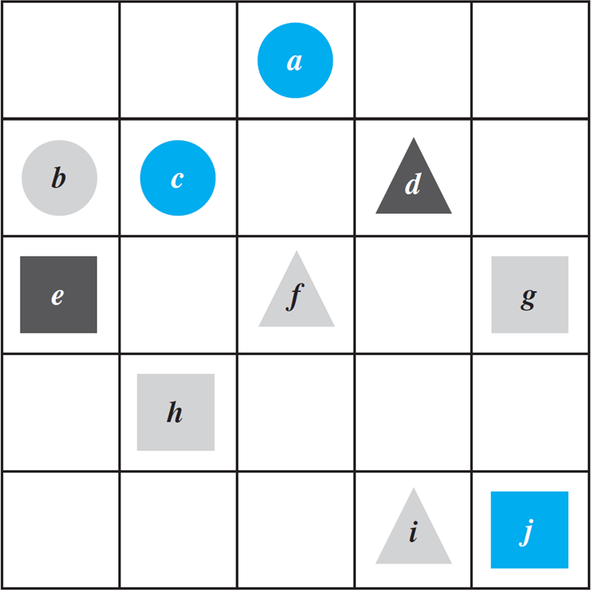
Formal Logic Notation
Let Triangle(x), Circle(x), and Square(x) mean “x is a triangle,” “x is a circle,” and “x is a square”; let Blue(x), Gray(x), and Black(x) mean “x is blue,” “x is gray,” and “x is black”;
let RightOf(x, y), Above(x, y), and SameColorAs(x, y) mean “x is to the right of y,” “x is above y,” and “x has the same color as y”; and use the notation x = y to denote the predicate “x is equal to y”.
Let the common domain D of all variables be the set of all the objects in the Tarski world.

Slide 50
Formal Logic Notation
Use formal, logical notation to write each of the following statements, and write a formal negation for each statement.
For all circles x, x is above f.
There is a square x such that x is black.
For all circles x, there is a square y such that x and y
have the same color.
There is a square x such that for all triangles y, x is to right of y.

Slide 51
Formal Logic Notation
Statement:
∀x(Circle(x) →Above(x, f )).
Negation:
∼(∀x(Circle(x) → Above(x, f ))
≡ ∃x ∼ (Circle(x) → Above(x, f ))
by the law for negating a ∀ statement
≡ ∃x(Circle(x) 𝖠 ∼Above(x, f ))
by the law of negating an if-then statement

Slide 52
Formal Logic Notation
Statement:
∃x(Square(x) 𝖠 Black(x)).
Negation:
∼(∃x(Square(x) 𝖠 Black(x))
≡ ∀x ∼ (Square(x) 𝖠 Black(x))
by the law for negating a ∃ statement
≡ ∀x(∼Square(x) 𝗏 ∼Black(x))
by De Morgan’s law

Slide 53
Formal Logic Notation
Statement:
∀x(Circle(x) → ∃y(Square(y) 𝖠 SameColor(x, y))).
Negation:
∼(∀x(Circle(x) → ∃y(Square(y) 𝖠 SameColor(x, y))))
≡ ∃x ∼ (Circle(x) → ∃y(Square(y) 𝖠 SameColor(x, y)))
by the law for negating a ∀ statement
≡ ∃x(Circle(x) 𝖠 ∼(∃y(Square(y) 𝖠 SameColor(x, y))))
by the law for negating an if-then statement
≡ ∃x(Circle(x) 𝖠 ∀y(∼(Square(y) 𝖠 SameColor(x, y))))
by the law for negating a ∃ statement
≡ ∃x(Circle(x) 𝖠 ∀y(∼Square(y) 𝗏 ∼SameColor(x, y)))
by De Morgan’s law

Slide 54
Formal Logic Notation
Statement:
∃x(Square(x) 𝖠 ∀y(Triangle(y) → RightOf(x, y))).
Negation:
∼(∃x(Square(x) 𝖠 ∀y(Triangle(y) → RightOf(x, y))))
≡ ∀x ∼ (Square(x) 𝖠 ∀y(Triangle(x) → RightOf(x, y)))
by the law for negating a ∃ statement
≡ ∀x(∼Square(x) 𝗏 ∼(∀y(Triangle(y) → RightOf(x, y))))
by De Morgan’s law
≡ ∀x(∼Square(x) 𝗏 ∃y(∼(Triangle(y) → RightOf(x, y))))
by the law for negating a ∀ statement
≡ ∀x(∼Square(x) 𝗏 ∃y(Triangle(y) 𝖠 ∼RightOf(x, y)))
by the law for negating an if-then statement

Slide 55
Formal Logic Notation
Formal logical notation is used in branches of computer science such as artificial intelligence, program verification, and automata theory and formal languages.
Taken together, the symbols for quantifiers, variables, predicates, and logical connectives make up what is known as the language of first-order logic.
Even though this language is simpler in many respects than the language we use every day, learning it requires the same kind of practice needed to acquire any foreign language.

Slide 56
Arguments with Quantified Statements
The rule of universal instantiation (in-stan-she-AY-shun) says the following:
Universal instantiation is the fundamental tool of deductive reasoning.
Mathematical formulas, definitions, and theorems are like general templates that are used over and over in a wide variety of particular situations.

Slide 57
Arguments with Quantified Statements
A given theorem says that such and such is true for all things of a certain type.
If, in a given situation, you have a particular object of that type, then by universal instantiation, you conclude that such and such is true for that particular object.
You may repeat this process 10, 20, or more times in a single proof or problem solution.

Slide 58
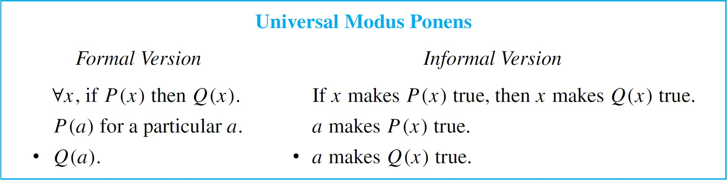
Universal Modus Ponens
The rule of universal instantiation can be combined with modus ponens to obtain the valid form of argument called universal modus ponens.

Slide 59
Universal Modus Ponens
Note that the first, or major, premise of universal modus ponens could be written “All things that make P(x) true make Q(x) true,” in which case the conclusion would follow by universal instantiation alone.
However, the if-then form is more natural to use in the majority of mathematical situations.

Slide 60
Universal Modus Ponens
Rewrite the following argument using quantifiers, variables, and predicate symbols. Is this argument valid? Why?
If an integer is even, then its square is even.
k is a particular integer that is even.
k² is even.
Solution:
The major premise of this argument can be rewritten as
x, if x is an even integer then x² is even.

Slide 61
Universal Modus Ponens
Let E(x) be “x is an even integer,” let S(x) be “x² is even,” and let k stand for a particular integer that is even.
Then the argument has the following form:
x, if E(x) then S(x).
E(k), for a particular k.
Therefore, S(k).
This argument has the form of universal modus ponens and is therefore valid.

Slide 62
Universal Modus Ponens
Here is a proof that the sum of any two even integers is even.
It makes use of the definition of even integer, namely, that an integer is even if, and only if, it equals twice some integer. (Or, more formally: integers x, x is even if, and only if, ∃ an integer k such that x = 2k.)
Suppose m and n are particular but arbitrarily chosen even integers. Then m = 2r for some integer r,⁽¹⁾ and n = 2s for some integer s.⁽²⁾

Slide 63
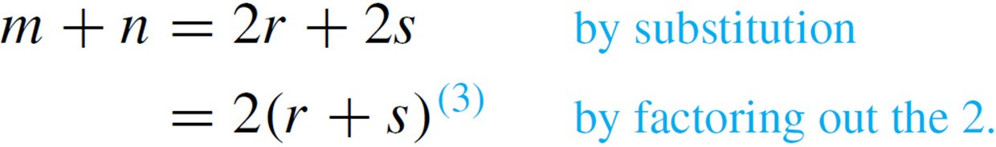
Universal Modus Ponens
Hence
Now r + s is an integer,⁽⁴⁾ and so 2(r + s) is even.⁽⁵⁾
Thus m + n is even.

Slide 64
Universal Modus Ponens
The following expansion of the proof shows how each of the numbered steps is justified by arguments that are valid by universal modus ponens.
If an integer is even, then it equals twice some integer.
m is a particular even integer.
m equals twice some integer r.
If an integer is even, then it equals twice some integer.
n is a particular even integer.
n equals twice some integer s.

Slide 65
Universal Modus Ponens
If a quantity is an integer, then it is a real number.
r and s are particular integers.
r and s are real numbers.
For all a, b, and c, if a, b, and c are real numbers, then ab + ac = a(b + c).
2, r, and s are particular real numbers.
2r + 2s = 2(r + s).

Slide 66
Universal Modus Ponens
For all u and v, if u and v are integers, then u + v is an integer.
r and s are two particular integers.
r + s is an integer.
If a number equals twice some integer, then that number is even.
2(r + s) equals twice the integer r + s.
2(r + s) is even.

Slide 67
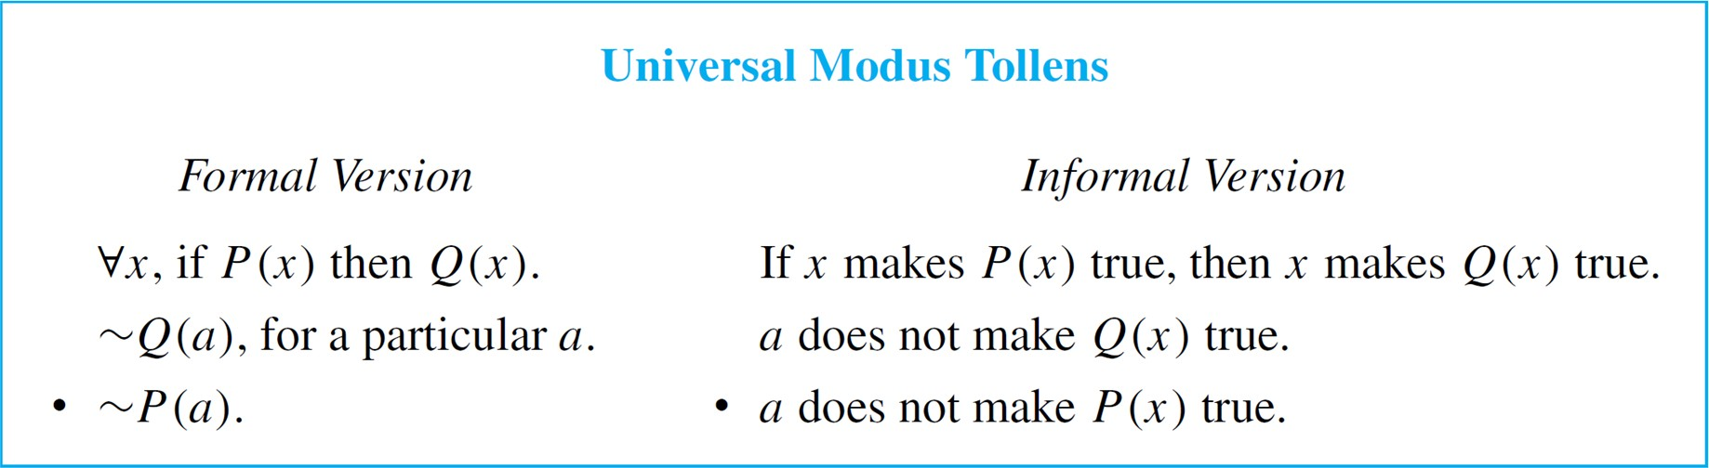
Universal Modus Tollen
Another crucially important rule of inference is universal modus tollens. Its validity results from combining universal instantiation with modus tollens.
Universal modus tollens is the heart of proof of contradiction, which is one of the most important methods of mathematical argument.

Slide 68
Universal Modus Tollen
Rewrite the following argument using quantifiers, variables, and predicate symbols. Write the major premise in conditional form. Is this argument valid? Why?
All human beings are mortal. Zeus is not mortal.
Zeus is not human.
Solution:
The major premise can be rewritten as
x, if x is human then x is mortal.

Slide 69
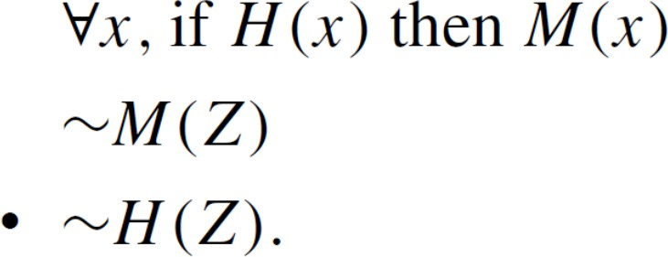
Universal Modus Tollen
Let H(x) be “x is human,” let M(x) be “x is mortal,” and let Z
stand for Zeus.
The argument becomes
This argument has the form of universal modus tollens and is therefore valid.

Slide 70
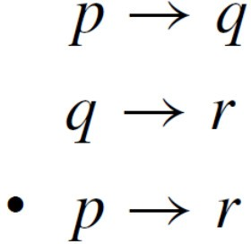
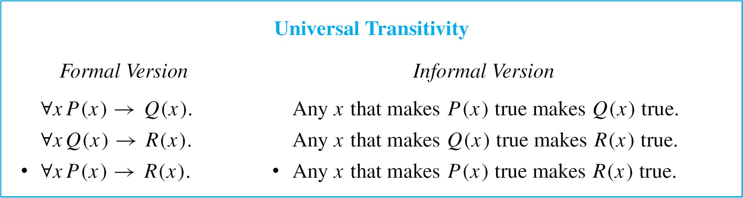
Universal Transitivity
Consider the following argument:
This argument form can be combined with universal instantiation to obtain the following valid argument form.

